Slide 1
Chapter 8 Aggregate Planning in the Supply Chain
Supply Chain Management

Slide 2
Role of Aggregate Planning in a Supply Chain
Capacity has a cost, lead times are greater than zero
Aggregate planning:
process by which a company determines levels of capacity, production, subcontracting, inventory, stockouts, and pricing over a specified time horizon
goal is to maximize profit for the Company and the Supply Chain(s)
decisions made at a product family (not SKU) level
time frame of 3 to 18 months
how can a firm best use the facilities it has?
All supply chain stages should work together on an aggregate plan that will optimize supply chain performance

Slide 3
Important Issues
Smoothing.
Refers to the costs and disruptions that result from making changes from one period to the next.
Bottleneck Planning.
Problem of meeting peak demand because of capacity restrictions.
Planning Horizon.
Assumed given (T), but what is “right” value?
Rolling horizons and end of horizon effect are both important issues.
Treatment of Demand.
Assume demand is known.
Ignores uncertainty to focus on the predictable/systematic variations in demand, such as seasonality.

Slide 4
Identifying Aggregate Units of Production
Aggregate unit should be identified in a way that the resulting production schedule can be accomplished in practice
Aggregate units may have products with very similar process plans, for example
Focus on the bottlenecks when selecting the aggregate unit and identifying capacity and production times
Account for activities such as setups and maintenance

Slide 5
Information Needed for an Aggregate Plan
Demand forecast in each period
Production costs
labor costs, regular time ($/hr) and overtime ($/hr)
subcontracting costs ($/hr or $/unit)
cost of changing capacity: hiring or layoff ($/worker) and cost of adding or reducing machine capacity ($/machine)
Labor/machine hours required per unit
Inventory holding cost ($/unit/period)
Stockout or backlog cost ($/unit/period)
Constraints: limits on overtime, layoffs, capital available, stockouts and backlogs

Slide 6
Outputs of Aggregate Plan
Production quantity from regular time, overtime, and subcontracted time: used to determine number of workers and supplier purchase levels
Inventory held: used to determine how much warehouse space and working capital is needed
Backlog/stockout quantity: used to determine what customer service levels will be
Machine capacity increase/decrease: used to determine if new production equipment needs to be purchased

Slide 7
Planning Approaches
Reactive approach:
Allow volume forecasts based on Marketing Plan to drive production planning
Proactive approach:
Coordinate Marketing & Production plans to level demand using advertising & price incentives

Slide 8
SCOR S&OP Planning Processes
P1 Plan Supply Chain (Sales and Operations Planning)
P1.1 Aggregate Demand
P1.3 Balance Demand & Supply
P1.4 Issue Supply Chain Plans
P1.2 Aggregate Supply
Days 9 - 12
Days 13 - 15
Days 0 - 8
P2
Plan SOURCE
P3
Plan MAKE
P4
Plan FULFILL
P5
Plan Return
Notes:
P1.1 Identify, Prioritize, and Aggregate Supply Chain Demand – includes requirements from existing customers, new customers, new products, spares, etc.
P1.2 Identify, Prioritize, and Aggregate Supply Chain Capability – includes make capability (machine capacity / labor / material), source capability (key vendors capacity), fulfill capability (transportation / delivery capacity), and other required capabilities.
P1.3 Balance Supply Chain Requirements with Supply Chain Resources – align make, source, fulfill, and other capabilities with requirements
P1.4 Establish and Communicate Supply Chain Plans – includes demand plan, production (make) plan, source plan, fulfill plan, inventory plan, financial plan, etc.
P2 Plan SOURCE – establish plans to acquire material resources needed to meet supply chain requirements. These
P3 Plan MAKE – establish plans to acquire production resources to meet production requirements.
P4 Plan FULFILL – establish plans to manage fulfillment resources to meeting fulfillment requirements
P5 Plan Return – establish plans to manage return resources and assets, including planned returns of containers for refurbishment and reissue to customers.

Slide 9
Aggregate Planning Strategies Chase Strategy
Demand
Units
Production
Time
Production rate is synchronized with demand by varying machine capacity or hiring and laying off workers as the demand rate varies
In practice, it is often difficult to vary capacity and workforce on short notice
Expensive if cost of varying capacity is high
Negative effect on workforce morale
Results in low levels of inventory
Should be used when inventory holding costs are high and costs of changing capacity are low

Slide 10
Aggregate Planning Strategies Level Strategy
Demand
Unit
Production
Time
Maintain stable machine capacity and workforce levels with a constant output rate
Shortages and surpluses result in fluctuations in inventory levels over time
Inventories that are built up in anticipation of future demand or backlogs are carried over from high to low demand periods
Better for worker morale
Large inventories and backlogs may accumulate
Should be used when inventory holding and backlog costs are relatively low

Slide 11
Aggregate Planning Strategies Time Flexibility Strategy
Can be used if there is excess machine capacity
Workforce is kept stable, but the number of hours worked is varied over time to synchronize production and demand
Can use overtime or a flexible work schedule
Requires flexible workforce, but avoids morale problems of the chase strategy
Low levels of inventory, lower utilization
Should be used when inventory holding costs are high and capacity is relatively inexpensive

Slide 12
Aggregate Planning Strategies Hybrid Strategies
Use a combination of options:
Build-up inventory ahead of rising demand & use backorders to level extreme peaks
Finished goods inventories: Anticipate demand
Back orders & lost sales: Delay delivery or allow demand to go unfilled
Shift demand to off-peak times: Proactive marketing
Overtime: Short-term option
Pay workers a premium to work longer hours
Undertime: Short-term option
Slow the production rate or send workers home early (lowers labor productivity, but doesn’t tie up capital in finished good inventories)
Reassign workers to preventive maintenance during lulls
Subcontracting: Medium-term option
Subcontract production or hire temporary workers to cover short-term peaks
Hire & fire workers: Long-term option
Change the size of the workforce
Layoff or furlough workers during lulls

Slide 13
Aggregate Planning Example
The washing machine plant is interested in determining work force and production levels for the next 8 months.
Forecasted demands for Jan-Aug. are:
420, 280, 460, 190, 310, 145, 110, 125
Starting inventory at the end of December is 200 and the firm would like to have 100 units on hand at the end of August.
Find monthly production levels.

Slide 14
Determine “net” demand….(subtract starting inv. from per. 1 forecast and add ending inv. to per. 8 forecast.)
Month Net Predicted Cum. Net
Demand Demand
1(Jan) 420-200=220 220
2(Feb) 280 500
3(Mar) 460 960
4(Apr) 190 1150
5(May) 310 1460
6(June) 145 1605
7(July) 110 1715
8(Aug) 125+100=225 1940

Slide 15
Zero Inventory Plan (Chase Strategy)
Assume number of workdays per month is given
K factor given (or computed) where
K = # of aggregate units produced in one day
by one worker
Suppose that we are told that over a period of 40 days, the plant had 38 workers who produced 520 units. It follows that:
K= 520/(38*40) = .3421
= average number of units produced in one day by one worker.

Slide 16
Addition of Costs
Zero Inventory Plan (Chase Strategy)
Holding Cost (per unit per month): $8.50
Hiring Cost per worker: $800
Firing Cost per worker: $1,250
Payroll Cost: $75/worker/day

Slide 17
Zero Inventory Plan (Chase Strategy)
Here the idea is to change the workforce each month in order to reduce ending inventory to nearly zero by matching the workforce with monthly demand as closely as possible.
This is accomplished by computing the # units produced by one worker each month (by multiplying K by #days per mo.) and then taking net demand each month and dividing by this quantity.
The resulting ratio is rounded up and possibly adjusted downward.

Slide 18
A Chase Strategy Solution to the Example
February # workers: (280 - 5.79) / 5.4736 = 50.096 → 51

Slide 19
Red Tomato Tools
Family | Material Cost/ Unit ($) | Revenue/ Unit ($) | Setup Time/Batch (hour) | Average Batch Size | Production Time/ Unit (hour) | Net Production Time/Unit (hour) | Percentage Share of Units Sold
A | 15 | 54 | 8 | 50 | 5.60 | 5.76 | 10
B | 7 | 30 | 6 | 150 | 3.00 | 3.04 | 25
C | 9 | 39 | 8 | 100 | 3.80 | 3.88 | 20
D | 12 | 49 | 10 | 50 | 4.80 | 5.00 | 10
E | 9 | 36 | 6 | 100 | 3.60 | 3.66 | 20
F | 13 | 48 | 5 | 75 | 4.30 | 4.37 | 15
Table 8-1

Slide 20
Red Tomato Tools
Weighted average approach
Material cost per aggregate unit
= 15 x 0.10 + 7 x 0.25 + 9 x 0.20
+ 12 x 0.10 + 9 x 0.20 + 13 x 0.15
= $10
Similarly
Revenue per aggregate unit = $40
Net production time per aggregate unit = 4.00 hours

Slide 21
Aggregate Planning Using Linear Programming
Red Tomato Tools
Highly seasonal demand
Develop a forecast
Month | Demand Forecast
January | 1,600
February | 3,000
March | 3,200
April | 3,800
May | 2,200
June | 2,200
average demand
per month = 2667
Table 8-2

Slide 22
Aggregate Planning at Red Tomato Tools
Table 8-3
Notes:
Notes:

Slide 23
Red Tomato Tools Decision Variables
For t = 1, ..., 6
W_{t} = Workforce size for month t
H_{t} = Number of employees hired at the beginning of month t
L_{t} = Number of employees laid off at the beginning of month t
P_{t} = Production in month t
I_{t} = Inventory at the end of month t
S_{t} = Number of units stocked out at the end of month t
C_{t} = Number of units subcontracted for month t
O_{t} = Number of overtime hours worked in month t

Slide 24
Red Tomato Tools Objective Function
Minimize
(Regular-time labor cost + Overtime labor cost + Cost of hiring and layoffs + Cost of holding inventory + Cost of stocking out + Cost of subcontracting + Material cost)
K = 4 hrs/unit

Slide 25
Aggregate Planning (Define Constraints Linking Variables)
Workforce size for each month is based on hiring and layoffs
Production for each month cannot exceed capacity
K = 4 hrs/unit
Notes:
Notes:

Slide 26
Aggregate Planning (Constraints)
Inventory balance for each month
Over time for each month
Notes:
Notes:

Slide 27
Red Tomato Tools
Average time
in inventory

Slide 28
Aggregate Planning at Red Tomato Tools Base Case (Integer restriction on W_{t} )
Table 8-4

Slide 29
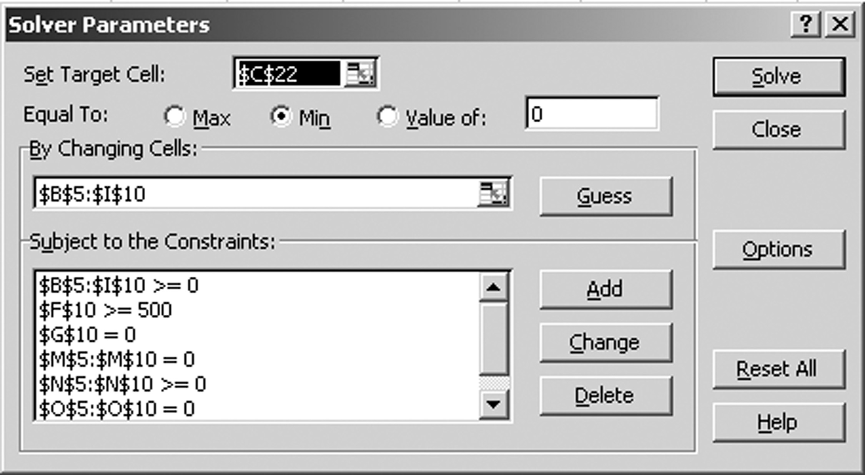
Aggregate Planning In Excel
Figure 8-4

Slide 30
Red Tomato Tools
Average seasonal inventory

Slide 31
Aggregate Planning at Red Tomato Tools Base Case (Integer restriction on W_{t} )

Slide 32
Building a Rough Master Production Schedule
Disaggregate an aggregate plan
Family | Setup Time/ Batch (hour) | Average Batch Size | Production Time/Unit (hour) | Production Quantity | Number of Setups | Setup Time (hours) | Production Time (hours)
A | 8 | 50 | 5.60 | 258 | 5 | 40 | 1,445
B | 6 | 150 | 3.00 | 646 | 4 | 24 | 1,938
C | 8 | 100 | 3.80 | 517 | 5 | 40 | 1,965
D | 10 | 50 | 4.80 | 258 | 5 | 50 | 1,238
E | 6 | 100 | 3.60 | 517 | 5 | 30 | 1,861
F | 5 | 75 | 4.30 | 387 | 5 | 25 | 1,664
Percentage Share of Units Sold
10
25
20
10
20
15
Table 8-8

Slide 33
Red Tomato Tools
Higher demand variability
Month | Demand Forecast
January | 1,000
February | 3,000
March | 3,800
April | 4,800
May | 2,000
June | 1,400
average demand
per month = 2667
Table 8-5
Average seasonal inventory

Slide 34
Red Tomato Tools
Higher Demand Variability Solution
Base Case
Total Cost =$ 422,660
Total Revenue = $ 640,000
Profit = $ 217,340

Slide 35
Red Tomato Tools
Lower hiring and layoff costs
Total cost over planning horizon = $412,688
Average seasonal inventory

Slide 36
Red Tomato Tools
Lower Cost of Hiring / Firing Solution
Base Case
Total Cost =$ 422,660
Total Revenue = $ 640,000
Profit = $ 217,340
Table 8-7

Slide 37
Aggregate Planning at Red Tomato Tools 25% increase in labor cost
Base Case
Total Cost =$ 422,660
Total Revenue = $ 640,000
Profit = $ 217,340

Slide 38
Aggregate Planning at Red Tomato Tools
Factor of 10 hiring and layoff cost reductions along with 25 % increase in labor cost
Base Case
Total Cost =$ 422,660
Total Revenue = $ 640,000
Profit = $ 217,340

Slide 39
Factor of 10 hiring and layoff cost reductions along with 25 % increase in labor cost

Slide 40
Aggregate Planning in Practice
Make plans flexible because forecasts are always wrong
Rerun the aggregate plan as new information emerges
Use aggregate planning as capacity utilization increases
Think beyond the enterprise to the entire supply chain
During peak demand, parts availability will limit production to 3000 in periods 3 and 4

Slide 41
Forecast Error in Aggregate Plans
Forecast errors must be considered
Safety inventory
Build and carry extra inventories as a form of safety inventory
Safety capacity
Use overtime as a form of safety capacity
Carry extra workforce permanently as a form of safety capacity
Use subcontractors as a form of safety capacity
Purchase capacity or product from an open or spot market as a form of safety capacity

Slide 42
Aggregate Planning at Red Tomato Tools Base Case: Limited production due to parts shortage
More units to be produced if parts available.
$13,040 profit reduction
Base Case
Total Cost =$ 422,660
Total Revenue = $ 640,000
Profit = $ 217,340

